Slide 1
Digital Transformation and Inclusion in East Africa
An API-driven data analytics assessment for the East African Communications Organization (EACO) Group 2
Data Analytics & Visualization Capstone
World Bank Indicators API | 2010–2024 | Kenya • Uganda • Tanzania • Rwanda • Burundi • Somalia • South Sudan

Slide 2
The Problem
What EACO needs to know to target digital-inclusion investment
Client question
• Digital access has expanded across East Africa, but adoption remains uneven.
• EACO needs comparable evidence across countries and over time.
• The analysis focuses on internet adoption, mobile connectivity and electricity access.
• The objective is to identify where the largest digital-inclusion gaps remain and what policy actions should be prioritized.
Six analytical questions
• Which country experienced the highest growth in internet users from 2010 to 2024?
• How does internet penetration compare with mobile subscriptions?
• Is electricity access associated with internet usage?
• Which country has the largest mobile–internet gap?
• How does Kenya compare with the regional picture?
• Which three interventions should EACO prioritize?
Source: World Bank Indicators API | Analysis: Python/Google Colab

Slide 3
Data and analytical workflow
1
API acquisition
2
Raw JSON
3
Quality assessment
4
Cleaning
5
Statistical analysis
6
Visualisation & recommendations
Dataset
• 7 EAC countries
• 2010–2024 analytical period
• 3 World Bank indicators
• Internet users (% of population)
• Mobile cellular subscriptions (per 100 people)
• Access to electricity (% of population)
Methods
• Trend and growth analysis
• Pearson and Spearman correlation
• Linear regression
• Mobile–internet gap analysis
• Kenya vs regional-average benchmarking
Source: World Bank Indicators API | Analysis: Python/Google Colab

Slide 4
Data quality assessment
Quality checks performed before analysis
0
Duplicate records
0
Duplicate country–year pairs
100%
Electricity data completeness
90.48%
Internet data completeness
Key quality findings
• Internet users: 10 missing observations (9.52%).
• Mobile subscriptions: 4 missing observations (3.81%).
• Electricity access: no missing observations in the analytical dataset.
• Three mobile-subscription observations were flagged as statistical outliers by the IQR rule.
Important limitations
• South Sudan has no comparable 2010 or 2024 internet observation in the extracted dataset.
• Somalia lacks a 2010 internet observation, so its 2010–2024 growth cannot be calculated.
• Burundi and Somalia have missing 2024 mobile-subscription values.
• Missing observations were not fabricated through interpolation.
Source: World Bank Indicators API | Analysis: Python/Google Colab

Slide 5
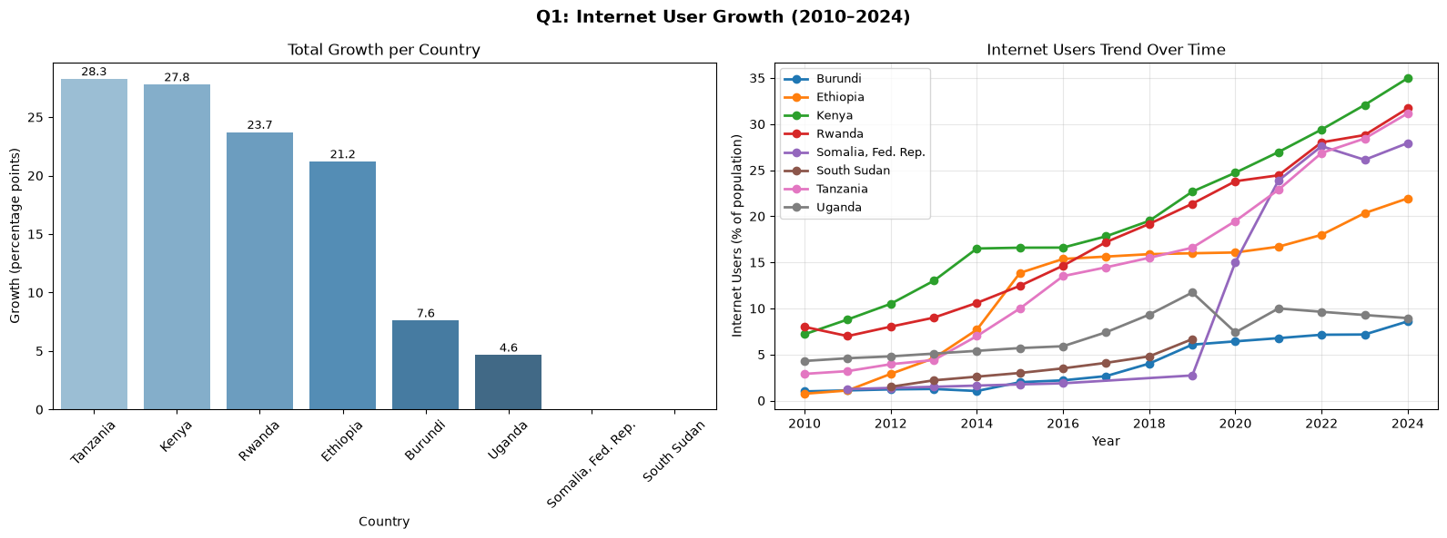
Country with HIGHEST growth: Tanzania: Growth: 28.26 percentage points
Country with NEGLIGIBLE growth: Somalia & South Sudan

Slide 6
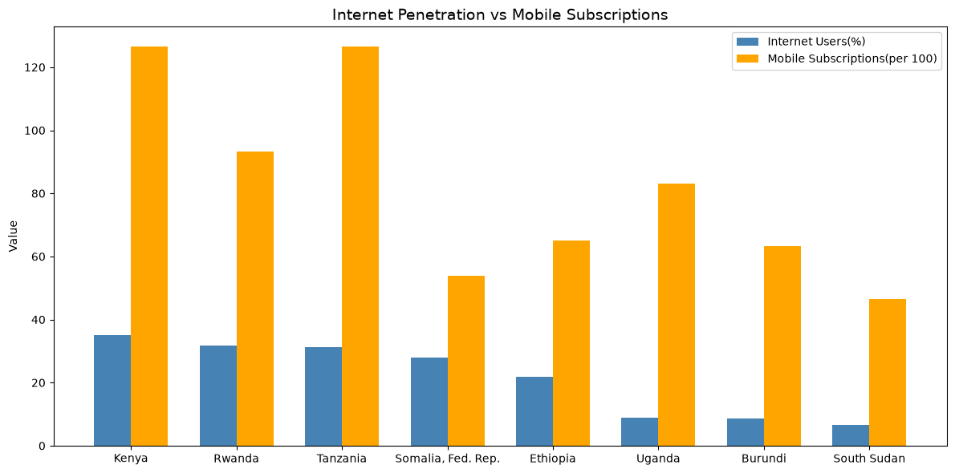
Mobile subscriptions far exceed internet penetration in all countries. This shows mobile are widely owned but internet adoption lags behind.

Slide 7
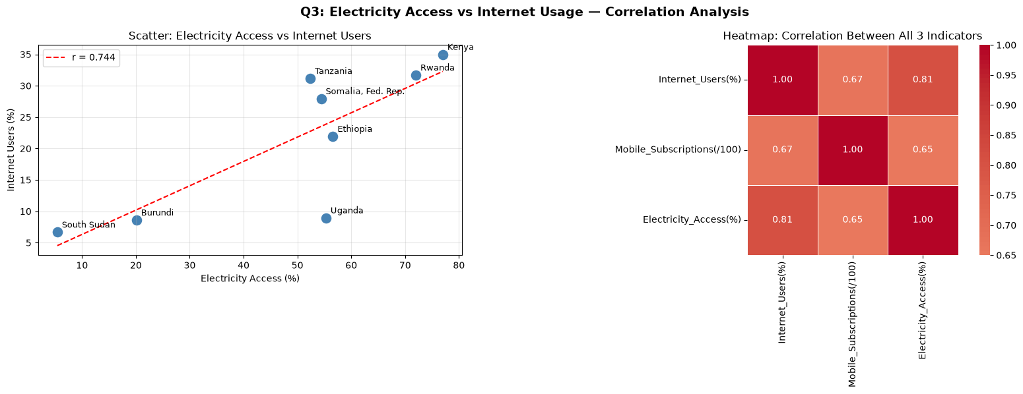
Based on the analytics above, we find that countries with higher electricity access tend to have higher internet usage. This confirms electricity is a foundational requirement for digital transformation. Meaning, without power, devices cannot be charged or connected. Correlation between Electricity and Internet: 0.744
Scatter plot: best for showing the relationship between two continuous variables.
Heatmap: standard visualization for a correlation matrix.

Slide 8
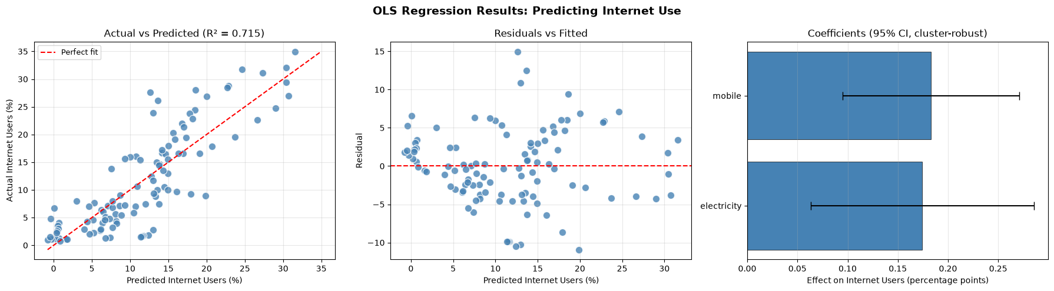
Regression Analysis
Actual vs. Predicted — each dot is a country-year. If the dots are close to the red diagonal line, the model's predictions are close to the real internet-usage numbers. Dots far off the line are cases the model can't explain well.
Residuals vs. Fitted — If the dots scatter randomly around the red zero-line, the model's errors are well-behaved. If you see a funnel shape or a curve, it's a sign the relationship isn't as simple as a straight line, or that some countries are systematically over/under-predicted.
Coefficient plot (right) — Each bar is one factor's effect size, and the whiskers are the 95% confidence interval — how much that estimate could plausibly be off. A blue bar means "statistically significant" (p < 0.05); gray means "can't confidently distinguish this effect from zero." If a bar's whiskers cross the black zero-line, it's not significant.

Slide 9
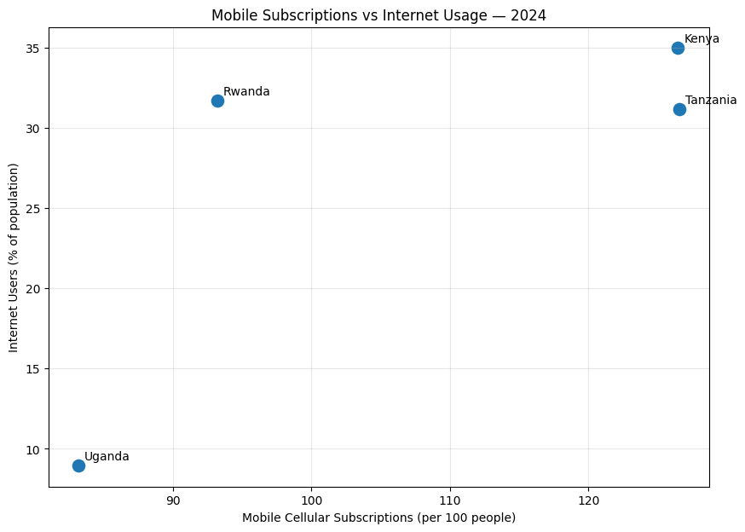
Mobile connectivity is much higher than internet adoption
2024 comparison of mobile subscriptions and internet usage
126.56
Tanzania mobile subscriptions / 100 people
31.16%
Tanzania internet users
Interpretation
• Kenya also shows very high mobile subscription density (126.48 per 100).
• The relationship is positive, but mobile subscriptions do not translate one-for-one into internet adoption.
Source: World Bank Indicators API | Analysis: Python/Google Colab

Slide 10
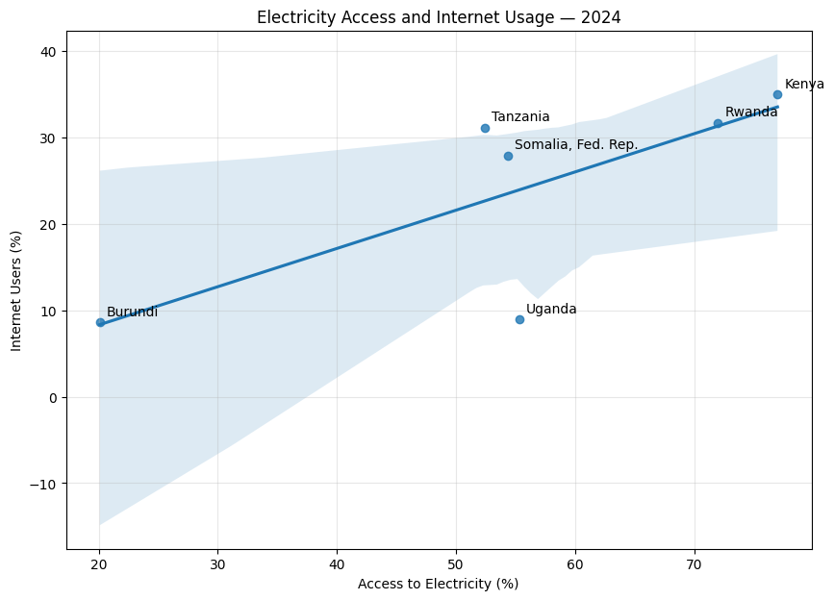
Electricity access is positively associated with internet use
2024 cross-country relationship; association is suggestive rather than causal
r = 0.743
Pearson correlation
R² = 0.551
Linear regression
p = 0.091
Pearson test
Statistical conclusion
• Positive association, but not statistically significant at the 5% level.
Source: World Bank Indicators API | Analysis: Python/Google Colab

Slide 11
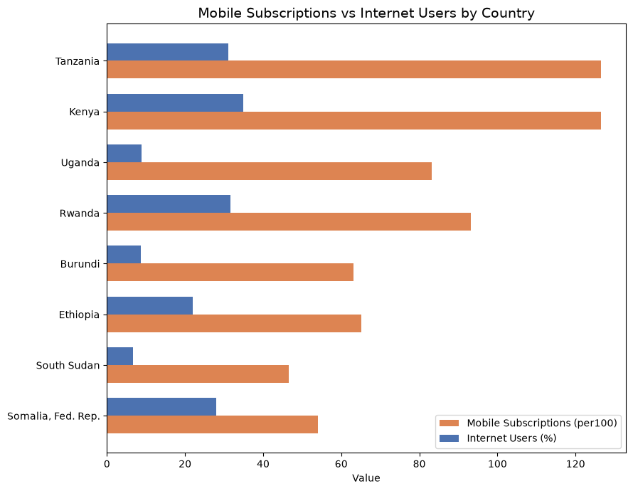
The largest mobile–internet gap is in Tanzania
2024 gap = mobile subscriptions per 100 people minus internet users (%)
95.40 pp
Tanzania's digital gap
2024 ranking
• Tanzania: 126.56 mobile subscriptions vs 31.16% internet users.
• Kenya: 126.48 vs 34.98% → 91.50 pp gap.
• Uganda: 83.17 vs 8.95% → 74.22 pp gap.
• Rwanda: 93.20 vs 31.70% → 61.50 pp gap.
Interpretation
• Note: subscriptions are not unique phone owners.
Source: World Bank Indicators API | Analysis: Python/Google Colab

Slide 12
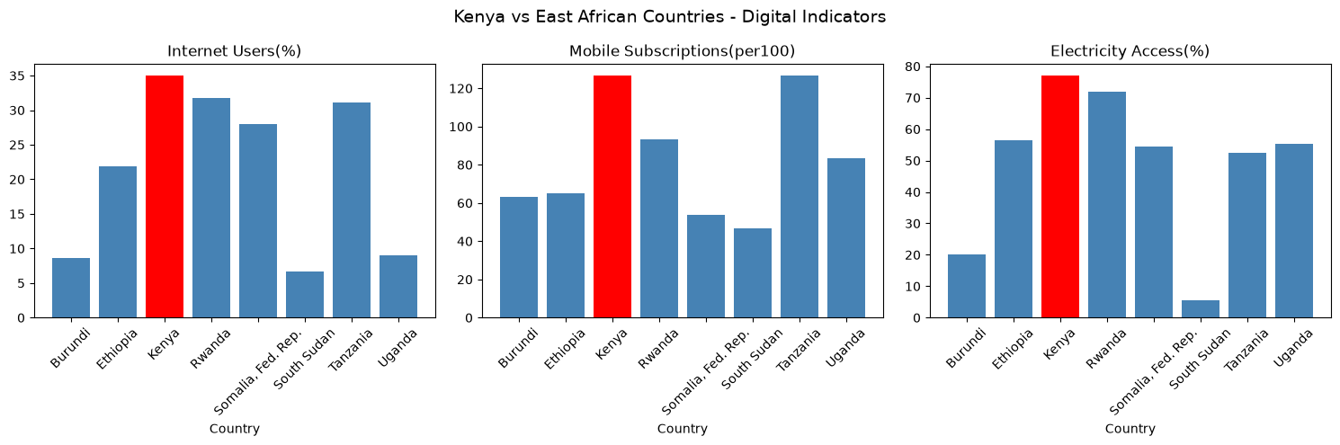
Kenya is ahead of the regional average on all three indicators
Consulting interpretation
• Kenya is one of the leading East African countries in digital transformation, consistently ranking among the top in internet penetration and mobile subscriptions. This reflects Kenya's investments in ICT infrastructure, mobile money (M-Pesa), and digital government services.
• However, Kenya still has a large mobile–internet gap (91.50 percentage points), indicating that connectivity infrastructure alone does not guarantee internet adoption.
Source: World Bank Indicators API | Analysis: Python/Google Colab

Slide 13
Three evidence-led priorities for EACO
Translate the observed gaps into targeted regional action
1
Close the mobile–internet adoption gap
Prioritize affordable last-mile broadband and internet adoption initiatives in countries where mobile subscription density is high but internet usage remains low.
Evidence: Tanzania 95.40 pp gap; Kenya 91.50 pp; Uganda 74.22 pp.
2
Integrate energy and digital infrastructure planning
Coordinate electricity-access expansion with digital connectivity investments, especially in underserved areas.
Evidence: 2024 electricity–internet correlation r = 0.743; regression R² = 0.551. The relationship is associative, not causal.
3
Target investment using country-level performance gaps
Use comparable country indicators to prioritize lagging markets rather than applying a one-size-fits-all regional intervention.
Evidence: 2024 internet usage ranges from 8.60% in Burundi to 34.98% in Kenya among countries with available observations.
Source: World Bank Indicators API | Analysis: Python/Google Colab

Slide 14
Three evidence-led priorities for EACO
POLICY 1: COORDINATE ELECTRIFICATION WITH CONNECTIVITY INVESTMENT
Evidence: high correlation between electricity access and
internet use is r = 0.744 (p < 0.001, n = 110), and the
regression confirms electricity remains a significant predictor after
controlling for mobile subscriptions. Countries with the lowest
electrification also have the lowest internet adoption. EACO should
advocate joint energy-connectivity planning: fibre along grid
extensions, solar-powered base stations off-grid.
POLICY 2: REVIEW SECTOR-SPECIFIC TAXES ON DATA AND DEVICES, AND
ZERO-RATE ESSENTIAL EDUCATION AND HEALTH SERVICES.
Evidence: in every country mobile subscriptions far exceed internet
use; the largest gap is Tanzania (95 points).
Networks reach far more people than use the internet, so the binding
constraints are demand-side.
POLICY 3: PRIORITISE UNIVERSAL SERVICE FUND DISBURSEMENT IN THE LAGGING COUNTRIES.
Evidence: Holt forecasts show that on current trends the region
diverges by 2028 - leaders (Kenya, Rwanda, Somalia, Fed. Rep., Tanzania) approach 40%+
while laggards (Burundi, South Sudan, Uganda) remain below 15%. Without
targeted intervention the digital divide inside East Africa widens.

Slide 15
Key takeaway
East Africa has made substantial progress in digital connectivity, but the analysis shows that mobile access, electricity and internet adoption are not advancing at the same level.
For EACO, the priority is therefore not only expanding infrastructure, but converting connectivity into meaningful internet adoption—especially in countries with the largest observed gaps.
Thank you

